Slide 1
DATA STRUCTURES AND ALGORITHM
ASSIGNMENT
SUBMITTED TO: submitted from:-
Yogesh (181210063) dr.chandresh kumar maurya
ABHISHEK LUTHRA (181210003)

Slide 2
CONTENTS
DIVIDE AND CONQUER ALGORITHM
BACKTRACKING ALGORITHM
GREEDY-METHOD ALGORITHM
DYNAMIC PROGRAMMING ALGORITHM
BRANCH AND BOUND ALGORITHM

Slide 3
DIVIDE AND CONQUER ALGORITHM
DEFINITION:- It is an algorithm design based on multi-branched recursion. A divide-and-conquer algorithm works by recursively breaking down a problem into two or more sub-problems of the same or related type, until these become simple enough to be solved directly. The solutions to the sub-problems are then combined to give a solution to the original problem.
PROBLEM: (MIN ELEMENT OF A GIVEN ARRAY)

Slide 4
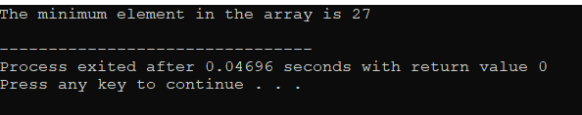
INPUT: Given an array elements which is defined as arr[ ]={27,32,99,65,56,76,91,88,42} in which we have to find the minimum element from a given array. OUTPUT: EXPLANATION:-Here in this problem, using Divide and Conquer algorithm we will find the minimum element. Initially, the given problem is subdivided into different problem as subproblems. Then we evaluate results corresponding to the subproblems and combining all these results to get the final output. Basically it works on the principle of recursion.

Slide 5
BACKTRACKING ALGORITHM
DEFINITION:- Backtracking is an algorithmic-technique for solving problems recursively by trying to build a solution incrementally, one piece at a time, removing those solutions that fail to satisfy the constraints of the problem at any point of time.
PROBLEM: (SUM OF SUBSETS)
INPUT: Given a set having elements which is defined as set[ ]={10,7,3,5,18,12,20,15,2,8} have 10 elements in which we have to find the number of subsets whose sum is equal to 30.

Slide 6
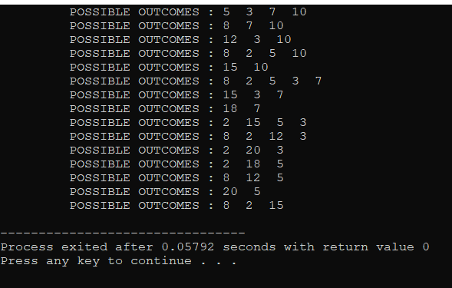
OUTPUT: EXPLANATION:-Here in this problem, using Backtracking algorithm ,from the given set we have to find the subsets having sum value =25. So, from the given set ,we list all the combinations starting from the set[1] value . List all the combinations whose value is <=25 and else other combinations will be deleted. Finally list the combination whose value is equal to 25 and delete the remaining.

Slide 7
GREEDY-METHOD ALGORITHM
DEFINITION:- Greedy is an algorithmic paradigm that builds up a solution piece by piece, always choosing the next piece that offers the most obvious and immediate benefit. So the problems where choosing locally optimal also leads to global solution are best fit for Greedy.
PROBLEM: (JOB SEQUENCING HAVING WEIGHTS TO EVALUATE MAXIMUM PROFIT)
INPUT: Given array consists of jobs, weights and profit having no of sequencing=5 which is defined as jobs[5] = {{"j1", 4, 80},{"j2", 6, 120},{"j3", 3, 20},{"j4", 5, 60},{"j5", 1, 40}}; in which have to find the sequence of jobs with number of weights(given) to calculate the maximum profit.

Slide 8
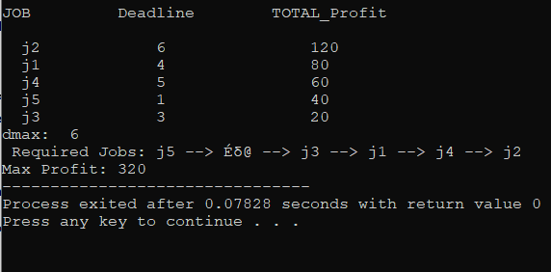
OUTPUT: EXPLANATION:-Here in this problem, using Greedy-approach algorithm we have given 5 different jobs ,deadline(as weights) and total profit . According to question dmax=6 (max deadline possible) ,we first put the jobs having more profit and least deadlines , continuing this process until we complete the entire sequence of jobs. The combination having max profit is finally listed.

Slide 9
DYNAMIC PROGRAMMING ALGORITHM
DEFINITION:- Dynamic Programming is mainly an optimization over plain recursion. Wherever we see a recursive solution that has repeated calls for same inputs, we can optimize it using Dynamic Programming. The idea is to simply store the results of subproblems, so that we do not have to re-compute them when needed later. This simple optimization reduces time complexities from exponential to polynomial.
PROBLEM:(TRAVELLING SALESMAN PROBLEM)
INPUT: Given array consists of 4 cities in which cost of moving from one city to another city is given as dist[10][10] ={{0,20,42,25},{20,0,30,34},{42,30,0,10},{25,34,10,0}}; in which have to find the minimum cost to travel all the cities.

Slide 10
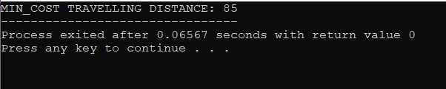
OUTPUT: EXPLANATION:-Here in this problem, using Dynamic Programming algorithm .Initially, 4 cities(given) .To calculate minimum cost we first make all the combinations covering all the cities having some travelling cost value. From all the combinations, we one by one check the cost which is minimum in value. This is an also optimisation approach.

Slide 11
BRANCH AND BOUND ALGORITHM
DEFINITION:- Branch and bound is an algorithm design paradigm which is generally used for solving combinatorial optimization problems. These problems are typically exponential in terms of time complexity and may require exploring all possible permutations in worst case. The Branch and Bound Algorithm technique solves these problems relatively quickly.
PROBLEM: (KNAPSACK PROBLEM)
INPUT: Given array consists of 5 items having weights and profit which is defined as Item arr[] = {{4, 65}, {2.5, 40}, {5.98, 120},{10, 95}, {6, 35}}; in which have to put the items having total weight = 10 . We have to find the the maximum profit from the different possible combinations.

Slide 12
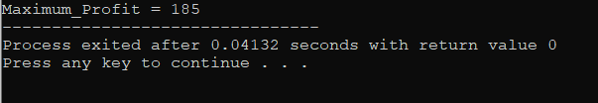
OUTPUT: EXPLANATION:-Here in this problem, using Branch and Bound algorithm we calculate max profit . Initially, total weight =10 (given) and from this corresponding to different weights with the bounded sum value <=10 , we list all the different combinations . Corresponding to different combinations we evaluate the max profit one by one to get the final answer.

Slide 13
THANKS……

